Slide 1
Personality

Slide 2
Personality
Personality: a person’s characteristic pattern of thinking, feeling, and acting.

Slide 3
Barnum Effect
Barnum effect: tendency of people to accept descriptions that apply to almost everyone as applying specifically to them.
What to look for:
Beware of all-purpose descriptions that could apply to anyone.
Beware of your own selective perceptions.
Resist flattery.

Slide 4
Trait Based Theories
Traits: a characteristic pattern of behavior or a disposition to feel and act.
Assessed by self-report inventories and peer reports.
Traits are enduring, states are temporary (e.g. a state of anger vs. an aggressive personality).
Trait based theories:
Focus on describing individual traits, not explaining their causes.

Slide 5
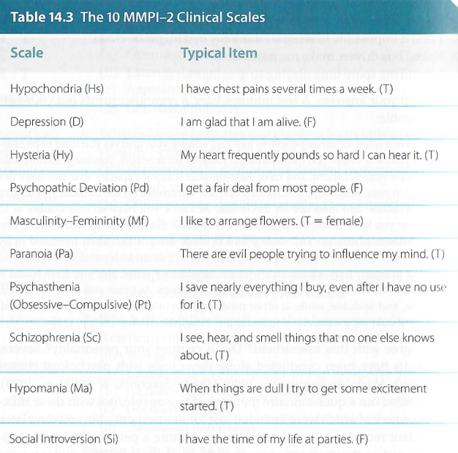
MMPI
Minnesota Multiphasic Personality Inventory (MMPI)
Describes a person’s psychological processes and how they respond to stress.
10 clinical scales developed to detect symptoms of mental health disorders.
True/False test
Reliable
Valid, but susceptible to faking.

Slide 6
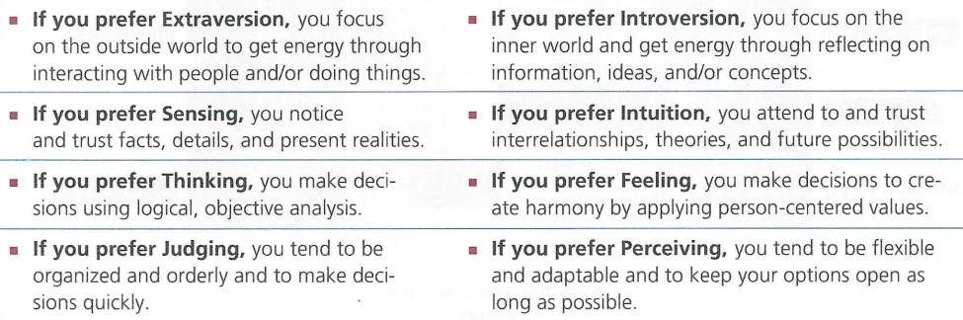
MBTI
Myers-Briggs Type Inventory (MBTI)
Introversion/ Extraversion
Sensing/ Intuition
Thinking/ Feeling
Judging/ Perceiving

Slide 7
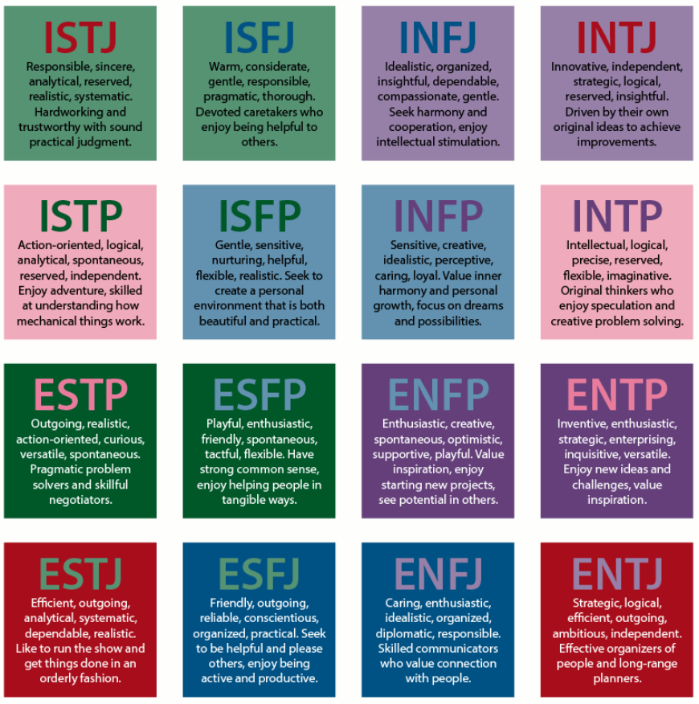
MBTI Pros
No bad outcomes.
Most people agree with their type profile.
Tidy way to sort people into categories.
Built-in schema for each category.
Self-fulfilling prophecy, confirmation bias.

Slide 8
MBTI Cons
Barnum effect
Low reliability
Low validity
Constructs?
Represented by categories rather than continuum.
Low predictive power
Most people fall somewhere in between, not extreme ends.

Slide 9
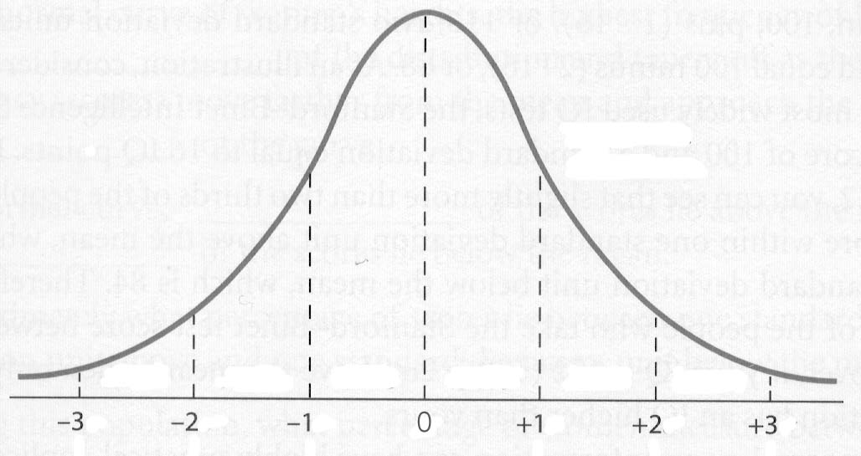
The Big Five
The Big Five:
Openness to experience
Conscientiousness
Extraversion
Agreeableness
Neuroticism
https://www.youtube.com/watch?v=IB1FVbo8TSs

Slide 10
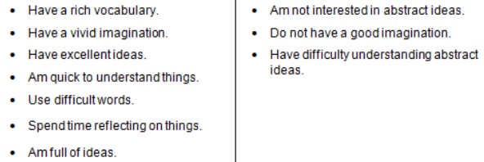
The Big Five
Openness to experience: tendency to enjoy new intellectual experiences and new ideas.
High: Variety of interests, willingness to try new things, curious, enjoys surprises.
Low: Traditional, practical, cautious, prefers familiar routines, people, and ideas.
E.g. High more likely to enroll in liberal arts programs, change careers more often, play a musical instrument, exhibit less racial prejudice.

Slide 11
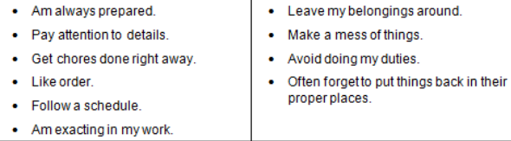
The Big Five
Conscientiousness: tendency to show self-discipline, be dutiful, strive for achievement and competence.
High: organized, goal-directed, responsible, careful, disciplined.
Low: impulsive, disorganized, careless.
E.g. High more likely to receive high ratings for job performance, drink less, smoke less, drive more safely, follow healthy diet, live longer.

Slide 12
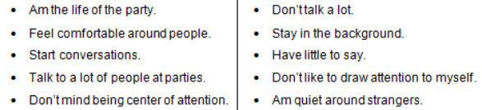
The Big Five
Extraversion: tendency to seek stimulation and enjoy the company of other people.
High: sociable, high-energy, assertive, talkative, enjoys meeting new people.
Low: reserved, quiet, dislikes being center of attention, prefers solitude.
E.g. High more likely to attend parties and be rated as popular by peers, live with and work with more people, less disturbed by loud sounds or intense stimuli.

Slide 13
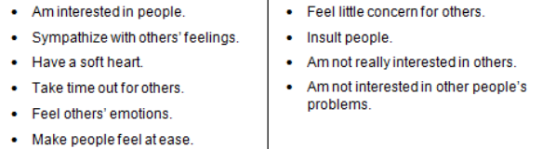
The Big Five
Agreeableness: tendency to be compassionate toward others.
High: cooperative, polite, friendly, trusting, shows concern for others.
Low: suspicious, skeptical, uncooperative.
E.g. High more willing to lend money, fewer behavioral problems during childhood, manifests less arrests in adulthood.

Slide 14
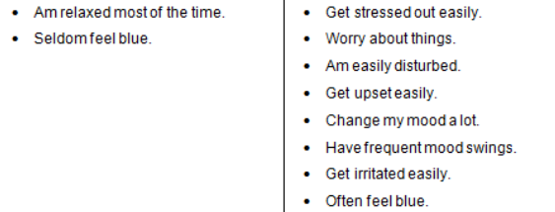
The Big Five
Neuroticism/ Emotional Stability: emotional stability is the tendency to minimize unpleasant emotions.
High: anxious, worried, angry, insecure, emotionally reactive, pessimistic.
Low: calm, composed, secure, satisfied with self.
E.g. High pays more attention to and exhibits better recall of threats and unpleasant information, manifest more distress when given a surprise math test, more susceptible to mental health issues.

Slide 15
The Big Five
HEXACO Model of Personality: Honesty-Humility
High: honest, modest, fair, generous, avoid manipulating others for personal gain.
Low: selfish, cruel, manipulative.
I wouldn’t use flattery to get a promotion at work, even if I thought it would succeed. | If I want something from someone I dislike, I will act very nicely toward that person is order to get it.
I wouldn’t pretend to like someone just to get that person to do favors for me. | If I want something from someone, I will laugh at that person’s worst jokes.
I am an ordinary person who is no better than others. | If I knew I would never get caught, I would be willing to steal a million dollars.
Having a lot of money is not especially important to me. | I would like to be seen driving around in a very expensive car.
I would never accept a bribe, even if it were very large. | I think that I am entitled to more respect than the average person.

Slide 16
The Big Five
Pros:
Each trait is an individual construct.
Continuum instead of categories.
Effectively captures change.
High reliability and validity.
High in predictive power.
Does not aggregate traits the way MBTI does.
Cons:
Does not encompass all of personality.
Culture differences.
Broad dimensions.
Not all positive.

Slide 17
The Big Five
What does the Big Five predict?
Conscientiousness related to job performance across jobs.
Conscientiousness predictive of academic performance.
Conscientiousness related to good health and life expectancy.
Extraversion related to job performance in sales and managerial jobs.
High neuroticism associated with higher rates of physical and mental illness.
High agreeableness related to increased helping behaviors.
Video game choice, in-game behaviors.

Slide 18
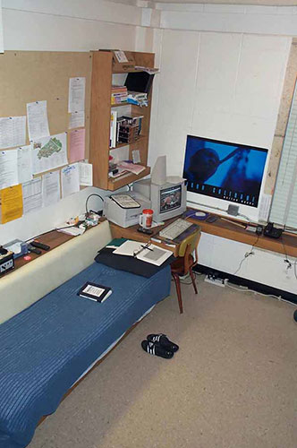
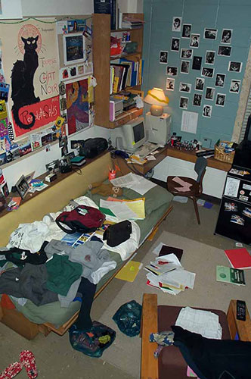
The Big Five
Zero acquaintance research:
Participants able to predict all Big Five traits from people’s bedrooms.
From offices, participants able to predict extraversion, conscientiousness, and openness.

Slide 19
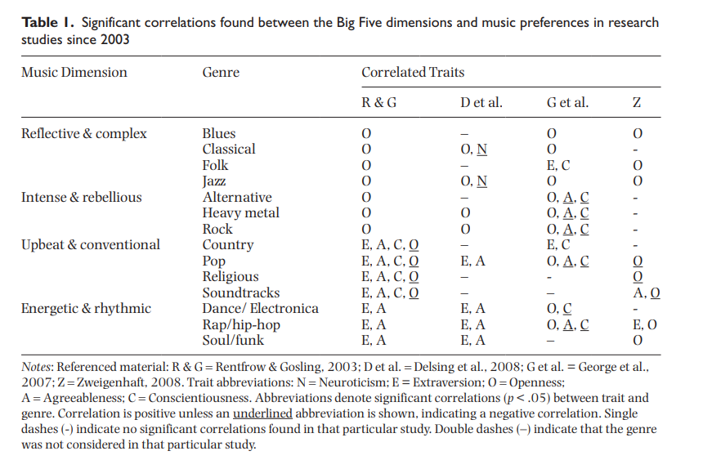
The Big Five

Slide 20
Personality Over Time
Personality traits are relatively stable over time. Research does find evidence of some changes:
Openness declines with age.
Agreeableness increases in 30s through 60s.
Conscientiousness begins to increase in 20s.
Extraversion increases during 20s to 60s.
Maturity principle: people generally become more agreeable, more conscientious, and less neurotic with age.

Slide 21
Social-Cognitive Perspective
Personality x situation
Traits are more easily expressed in some situations than others.
Different people choose different environments.
Our personality shapes how we interpret and react to events.
Our personalities create situations to which we react.
Improving predictive power of a personality test by using an explicit frame-of-reference.
The best predictor of future behavior is the person’s past behavior in similar situations.

Slide 22
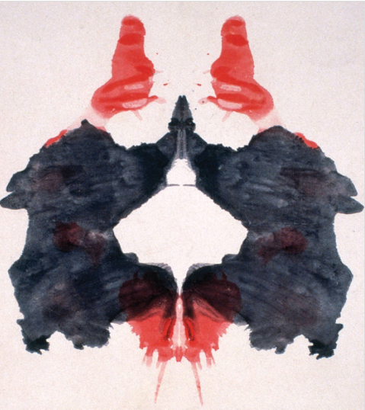
Other Personality Approaches
Projective tests: people interpret ambiguous stimuli.
Thematic Apperception Test (TAT)
Interpretation of an ambiguous photo reveals our unconscious self.
https://www.youtube.com/watch?v=i2gn_9m3hx0
Poor psychometric properties (validity, reliability).
Some empirical support for identifying problem solving style and interpersonal dynamics.
Rorschach inkblot tests
Poor psychometric properties.
Generally does not yield information that could not be obtained through biographical reports or other measures.

Slide 23
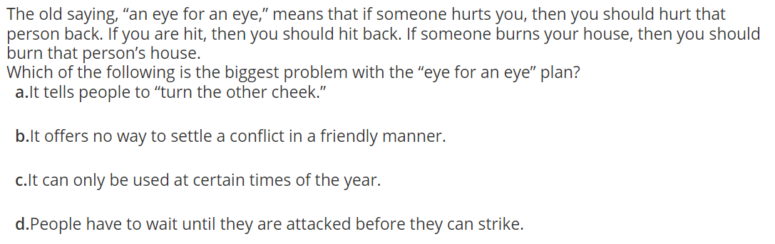
Other Personality Approaches
Conditional reasoning: given a scenario, participants are asked to make logical inferences.
Justification mechanisms: the way people defend their own behavior.

Slide 24
Other Personality Approaches
Humanistic approach
Comparing a person’s ideal self to actual self.
Life story approach: collecting a rich narrative of a person’s life.
Criticisms: focuses on actualizing ideal self without addressing our capacity to do bad things, too vague and subjective.
Psychoanalytic perspective
Freud: personality is attributed to unconscious motives, largely repressed.
Criticism: post hoc, no way to empirically verify.

Slide 25
Faking on Personality Tests
Impression management: making ourselves look better than we are.
People can and do fake when stakes are high, such as in employment settings.
Social desirability scales
But does it matter?

Slide 26
Faking on Personality Tests
Yes:
Threatens validity.
Predictive until it’s not.
Might pass over a candidate who’s a better fit.
Faking might not translate to behaviors on the job (e.g. emotional labor).
No:
Being able to identify the socially desirable response and fake it can be a valuable skill.
If results predict job performance, why does it matter?
Attitudes and behaviors link: saying will become believing.

